Slide 1
DY Emergency Response Report 2 - Software Project Management Plan
Supervisor:
Ngô Đăng Hà An
Team members:
Ngô Thục Thiên Bình
Mohammad Firdaus bin Haji Jais
Phạm Thị Xuân Hạ
Muhd. Wafi Nur Arif bin Shamdi
Hoàng Nhựt Vũ

Slide 2
AGENDA
Problem Definition
Name of this Capstone Project
Problem Abstract
Project Overview
Current Situation
The Proposed System
Boundaries of the System
Future Plan
Development Environment
Project Organization
Software Process Model
Roles and Responsibilities.
Tools and Techniques.
Project Management Plan
Product Backlog
Deliverables
Coding Convention

Slide 3
Problem Definition
Name of this Capstone Project
Problem Abstract
Project Overview
Current Situation
The Proposed System
Boundaries of the System
Future Plan
Development Environment

Slide 4

Name of this Capstone Project
Official name: Discovery Year (DY) Emergency Response.
Vietnamese name: hệ thống thông báo khẩn cấp.
Abbreviation: DYER.

Slide 5



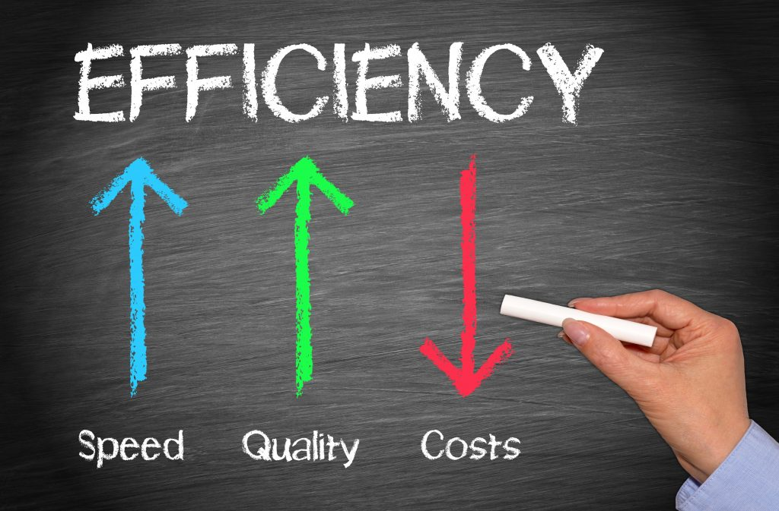
Problem Abstract

Slide 6

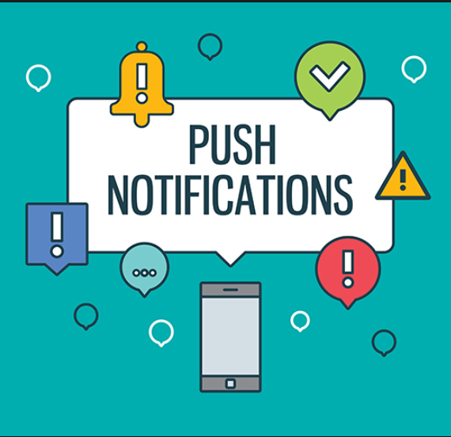
Current situation
Currently, Discovery Years (DY) is 80% of their student will go out of country, and there is no program or system can help teacher of UBD can quickly know their student’s status.
They need an application can help them easy to make a notification and receive student’ answer status automatically not manually like now.

Slide 7


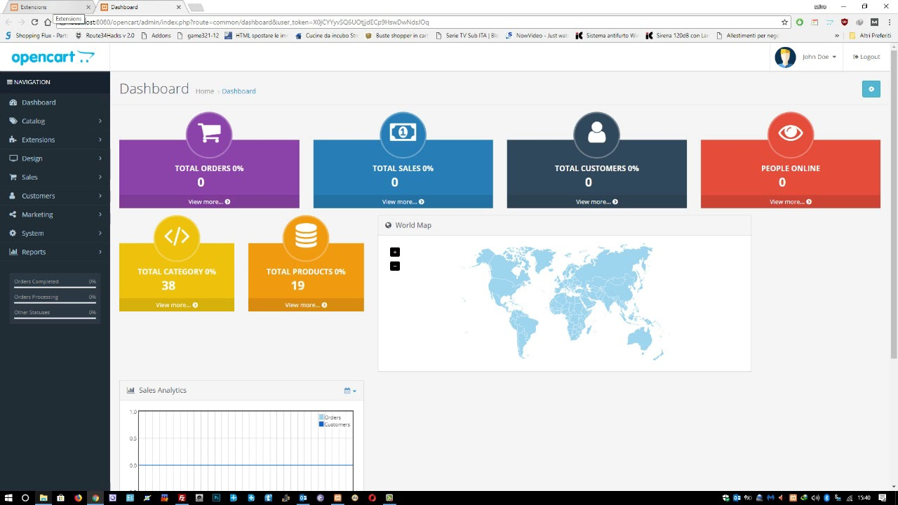
Proposed solution
DYC App
Student App
Web Admin
Feature Functions
Coordinators can only see information about their own faculties’ students.
Coordinators can only send notifications to their own students.
Coordinators are able to view responses to their notifications.
Student can view information about themselves and their host organisation and country.
Student can respond to notifications from their coordinators.
Website administrator are able to view all information of the students.
Website administrator are able to create notifications for all students.
Website administrator can generate a report from the website.

Slide 8
Proposed solution
Student :
Students that are going abroad for their Discovery Year are able to log into this mobile application.
Prompted to log into the application once. Subsequent logins on the same device do not ask for authentication.
The account expire at the end of their Discovery Year.
See basic information of the organisation they are attached to.
Give report to their Discovery Year coordinators in cases of emergency.
Receive notification from their Coordinators or Administrators.
Respond to notifications.
Ability to update their new phone number while in host country.

Slide 9
Proposed solution
Coordinator :
Prompted to log into the application once. Subsequent logins on the same device do not ask for authentication.
Able to view information about their own faculties’ students.
Able to view list of their students by country.
Create notification to one or more students at a time.
View students’ responses to their notifications.
View number of students who have or have not responded to their notifications as well as the information pertaining to those students.
Receive notification from Administrator.

Slide 10

Proposed solution
Administrator :
Log in to website.
Manage accounts of other administrators, coordinators and students.
Manage every aspect of information in user-friendly database.
Create notification to one or more students at a time.
View students’ responses to their notifications.
View number of students who have or have not responded to their notifications as well as the information pertaining to those students
Generate report.

Slide 11
Boundaries of the System
The system works under the assumption that the user’s device has an active internet connection.
The system can:
Allow DYC know list of their faculty’s students and the country they go abroad.
Allow Admin and DYC to send the notification to student’s device.
Allow Admin to manage DYC’s staff and student abroad and host organization.
Allow DYC quickly know about their student’s status in case emergency.
Allow Admin to see the report from DYC.
The system cannot:
Run without internet connection and database.

Slide 12

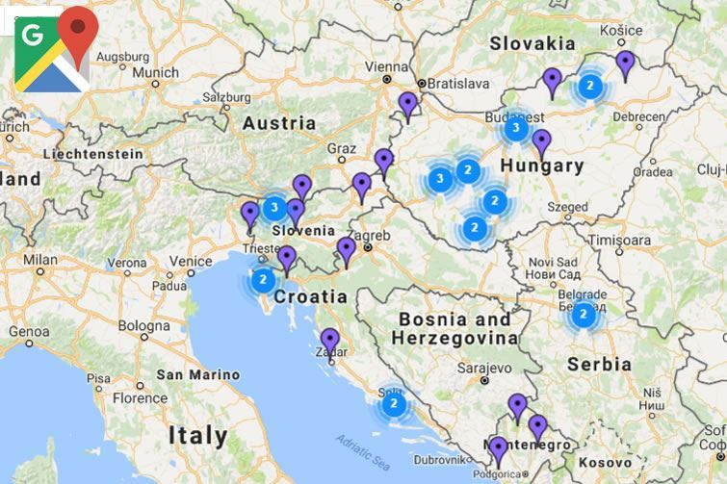


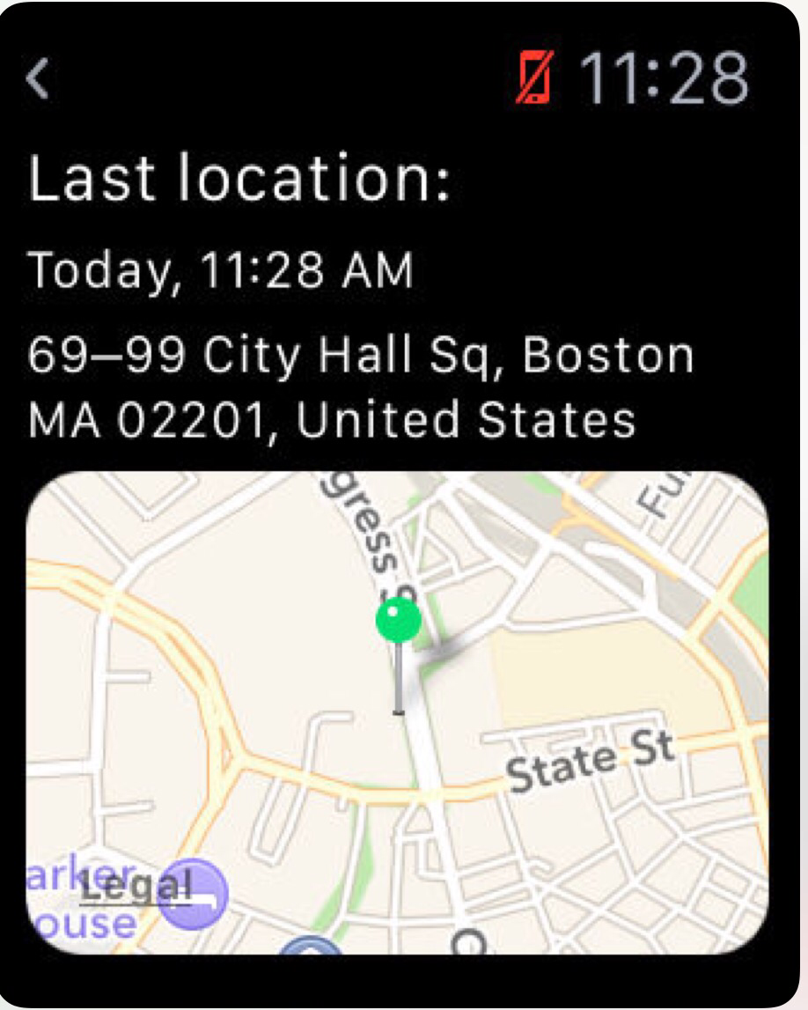
Future Plan
In the future, we want to upgrade and develop the system with following features:
Manage more than 1000 students

Slide 13
Development Environment Hardware Requirements
Server | Minimum Requirements | Recommended
Internet Connection | Cable (4 Mbps) | Cable (8 Mbps)
Operating System | Window Server 2008 | Window Server 2008
Computer Processor | Intel® Xeon ® 1.4GHz | Intel® Xeon ® Quad Core (12M Cache, 2.50 GHz)
Computer Memory | 4GB RAM | 8GB or more

Slide 14
Development Environment Hardware Requirements
PC | Minimum Requirements | Recommended
Internet Connection | Cable, Wi-Fi (4 Mbps) | Cable, Wi-Fi (8 Mbps)
Operating System | Window 7 | Window 7 or more.
Computer Processor | Intel® Core i3 1.4GHz | Intel® Core i5 2.50GHz
Computer Memory | 1GB RAM | 2GB RAM or more
Web Browser | Firefox (v52 or higher), Chromes (v28 or higher) | Chrome latest stable version
Mobile Phone | Minimum Requirements | Recommended
Internet Connection | Wi-Fi (4 Mbps) | Wi-Fi (8 Mbps)
Operating System | Android, IOS | Android, IOS lates verison
Phone Memory | 1GB RAM | 2GB RAM or more

Slide 15
Development Environment Software Requirements
Software | Name/ Version | Description
Operating System | Windows 8 or above | Operating system and platform for development
IDE | Visual Studio 2017 | Used for implementing website and phone mobile
Design Model Tool | StarUML v2.5.1 | Used for creating model and diagram
Design UI Tool | Adobe XD | Used for create UI prototype
DBMS | SQL Server 2014 | Used for creating & managing database
Document storage | Google Drive | Used for storing documents
Store and manage source code | Github with Source Tree | Used for storing source code
Communication | Facebook, Whatsapp, Email, | Used for exchanging information, online meeting, communication
Web browser | Chrome 28 or higher | Testing browser
Mobile Phone | Iphone SE, Sony Phone | Testing mobile application

Slide 16
Project Organization
Software Process Model
Roles and Responsibilities
Tools and Techniques.

Slide 17
Roles and Responsibilities
No. | Full name | Role in Group | Responsibilities
1. | Ngô Đăng Hà An | Supervisor, Product owner | Specify user requirements Control the development process Support in technique and business logic.
2. | Ngô Thục Thiên Bình | Team Leader, BA, Developer, Tester | Manage process Plan Scrum implementations Clarify requirements Design database Code on Web Application Write document and report Test Contact with client Research technology Design GUI Website Provide API for Mobile
3. | Mohammad Firdaus bin Haji Jais | Team member, Developer, Tester | Clarify requirements Design database Code Web Application Write document and report Test Contact with client Research technology Design GUI Website Provide API for Mobile

Slide 18
Roles and Responsibilities
No. | Full name | Role in Group | Responsibilities
4. | Phạm Thị Xuân Hạ | Team member, Developer, Tester | Design GUI Mobile Clarify requirements Design database Code on Mobile Application Test Create test plan Write document and report Research technology
5. | Muhd. Wafi Nur Arif bin Shamdi | Team member, Developer, Tester | Design GUI Mobile Clarify requirements Design database Code on Mobile Application Test Write document and report Research technology
6. | Hoàng Nhựt Vũ | Team member, Developer, Tester | Design GUI Mobile Clarify requirements Design database Code on Mobile Application Test Write document and report Research technology

Slide 19
Tools and Techniques
Tool/Technique | Name/Version
Front-end | HTML5, CSS3, Bootstrap, Javascript/jQuery, AdminLTE
Back-end | C#, .NET Framework
Managing Database | Microsoft® SQL Server® 2014 Management Studio
Source Control | Sourcetree (server github.com)
Modeling Tool | StarUML v2.8.1
Web Browser | Google Chrome
Mobile Application | Xamarin Cross-Platform/ lates version
Mobile Phone | Iphone, Android phone

Slide 20
Project Management Plan
Product Backlog
Deliverables

Slide 21
Product Backlog
Story ID | Features | Task ID | Task description | Sprint
1 | Create Product Backlog | 1.1 | Create product backlog | 1
2 | Create Introduction document | 2.1 | Create introduction document | 1
 |  | 2.2 | Review introduction document | 1
3 | Learning Xamarin | 3.1 | Learning Xamarin Cross-Platform | 1
 | Learning MVC API, Entity Framework | 3.2 | Learning MVC API, Entity Framework | 1
 | Learning Firebase Push Notification | 3.3 | Learning Firebase Technology | 1
4 | Create UI mockups | 4.1 | Search for suitable UI | 2
 |  | 4.2 | Login Mobile UI | 2
 |  | 4.3 | Admin Mobile UI | 2
 |  | 4.4 | DYC Mobile UI | 2
 |  | 4.5 | Student Mobile UI | 2
 |  | 4.6 | Login Website UI | 2
 |  | 4.7 | Admin Website UI | 2
 |  | 4.8 | DYC Website UI | 2

Slide 22
Product Backlog
Story ID | Features | Task ID | Task description | Sprint
5 | Create Software Project Management Plan | 5.1 | Problem definition | 2
 |  | 5.2 | Project organization | 2
 |  | 5.3 | Project management plan | 2
 |  | 5.4 | Coding convention | 2
6 | Create Software Requirement Specifications | 6.1 | User requirement specification | 2
 |  | 6.2 | External interface requirement | 2
 |  | 6.3 | Use case diagram | 3
 |  | 6.4 | Software system attributes | 2
 |  | 6.5 | Database diagram | 2
7 | Create Software Design Description | 7.1 | Design overview | 3
 |  | 7.2 | System architectural design | 3
 |  | 7.3 | Component diagram | 3
 |  | 7.4 | Detailed description of components | 3
 |  | 7.5 | Sequence diagram | 3
 |  | 7.6 | User interface design | 2
 |  | 7.7 | Database design | 3
 |  | 7.8 | Coding | 3 to 6
8 | Create Software Test Documentation | 8.1 | Test Plan | 5
 |  | 8.2 | Test Cases | 5
 |  | 8.3 | Checklists | 6
9 | Software User’s Manual | 9.1 | Installation Guide | 6
 |  | 9.2 | User’s Guide | 6

Slide 23
Deliverables
No | Deliverable | Delivery date | Delivery location | Note
1 | Introduction Document, Task list | 13/10/2018 | Supervisor’s office | Report No.1
2 | Software Project Management Plan | 13/10/2018 | Supervisor’s office | Report No.2
3 | Software Requirements Specification | 20/10/2018 | Supervisor’s office | Report No.3
4 | Software Design Description | 30/10/2018 | Supervisor’s office | Report No.4
5 | Software Test Documentation Guide Implementation (Coding) | 10/11/2018 | Supervisor’s office | Report No.5
6 | Software User’s Manual | 20/11/2018 | Supervisor’s office | Report No.6

Slide 24
Coding Convention
Naming conventions :
Log in to website.
Manage accounts of other administrators, coordinators and students.
Manage every aspect of information in user-friendly database.
Create notification to one or more students at a time.
View students’ responses to their notifications.
View number of students who have or have not responded to their notifications as well as the information pertaining to those students
Generate report.
Layout conventions:
Tabs must be set exactly 4 spaces.
Avoid lines longer than 80 characters.
Vertically align curly brackets.
Write only one statement per line.
Write only one declaration per line.
Add one blank line between method definitions and property definitions.

Slide 25
Coding Convention
Declaration:
Use implicit type ‘var’ for local variable declarations. Except: primitive types (int, string, double, etc.) use predefined names.
Organize namespaces with a clearly defined structure.
Commenting conventions:
Place comment on a separate line.
Begin comment text with an uppercase letter and end with a period.
Add one space between comment delimiter (//) and comment text.

Slide 26
THANKS FOR WATCHING

